Slide 1

Quitting Smoking in Ontario
Findings from the Ontario Tobacco Research Unit

Slide 2
Trying to Quit

Slide 3
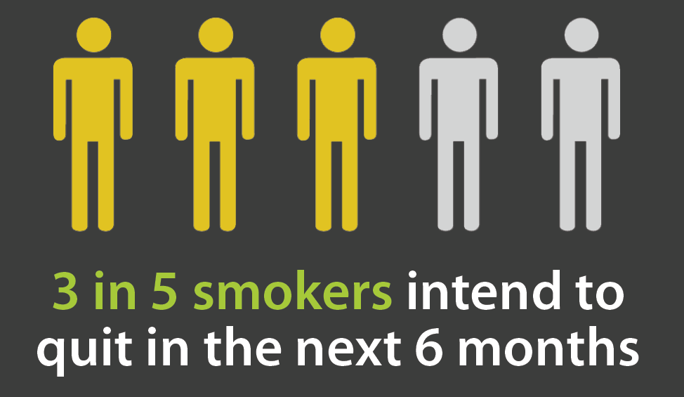

Slide 4
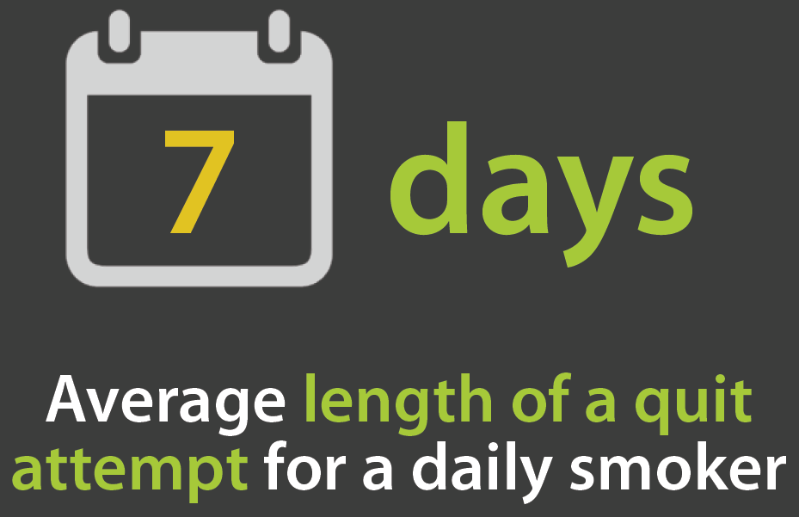

Slide 5
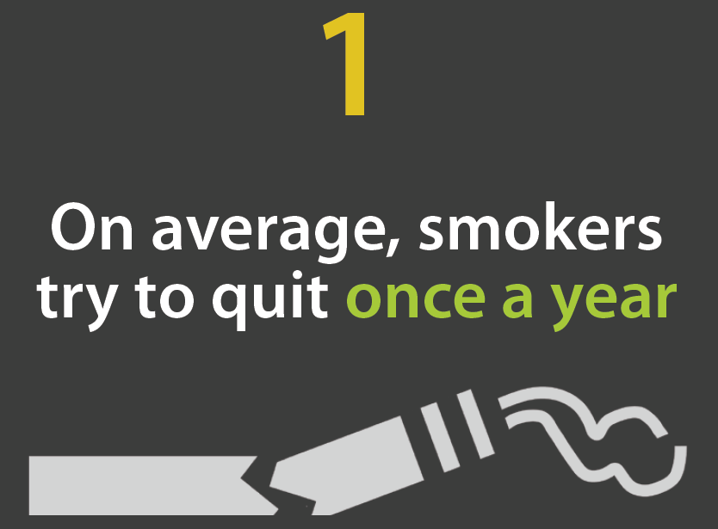

Slide 6
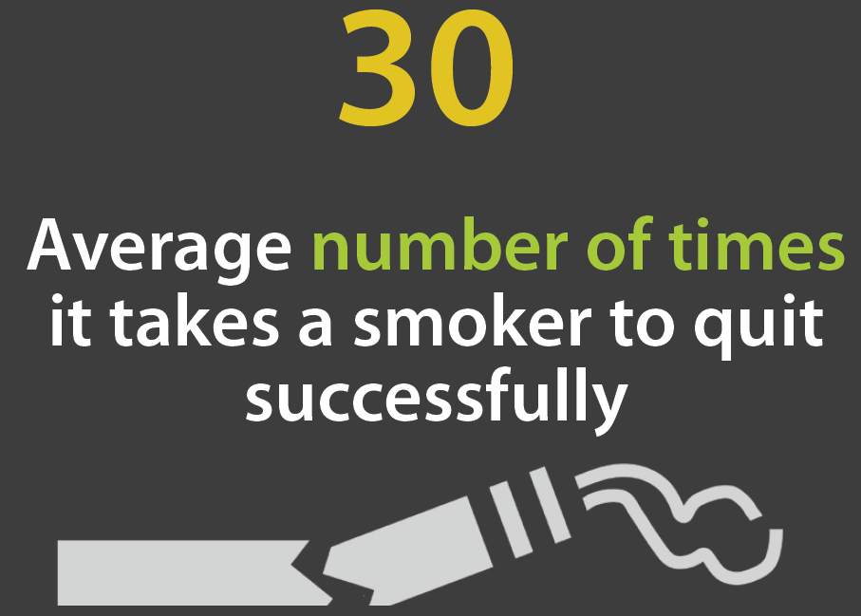

Slide 7
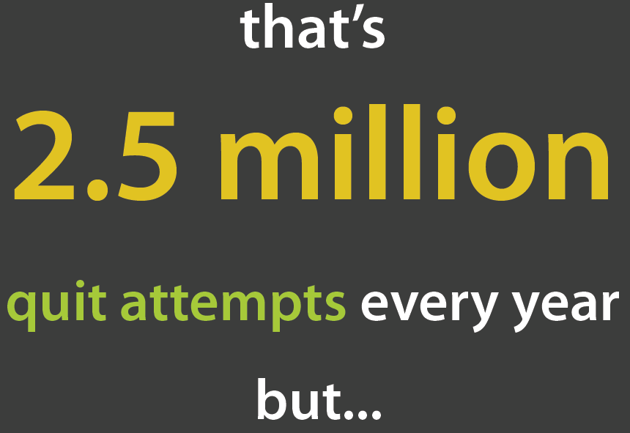

Slide 8
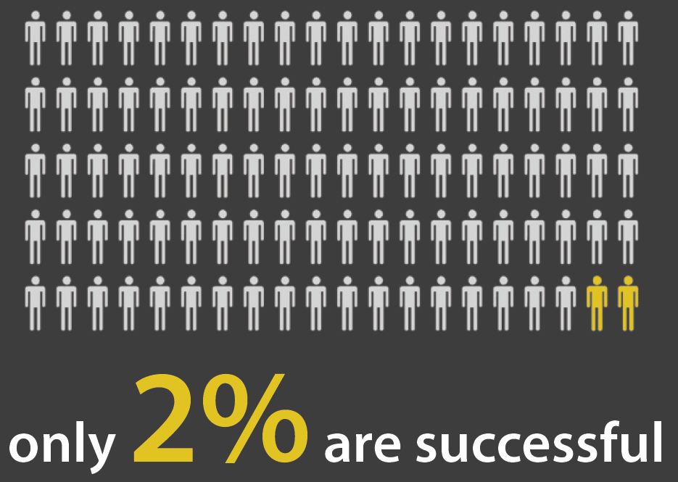

Slide 9
Factors that affect quitting

Slide 10


Slide 11
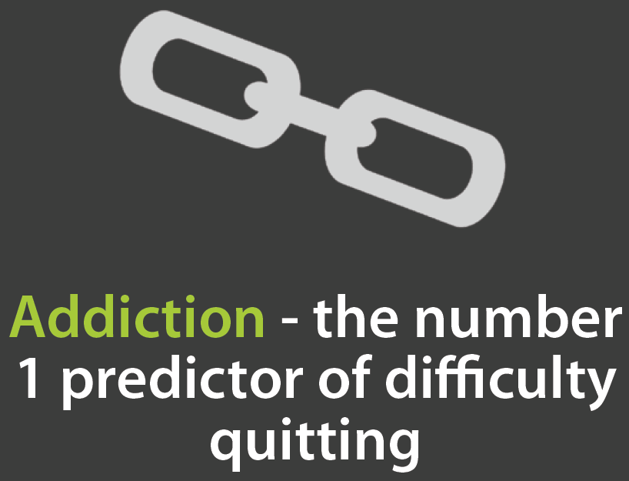

Slide 12
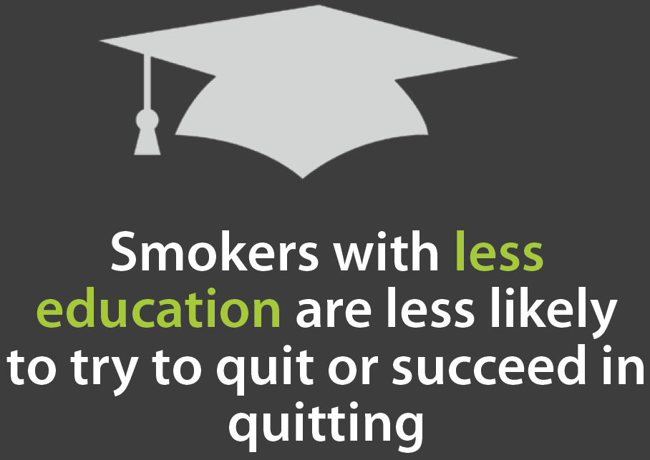

Slide 13
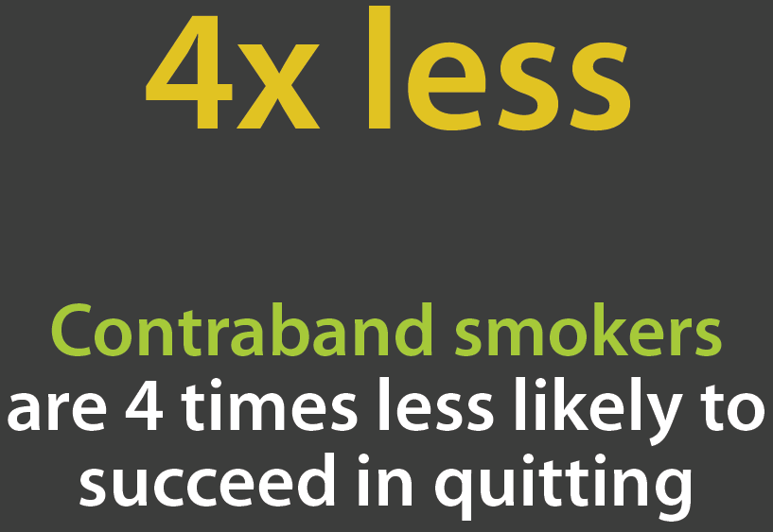

Slide 14
Top Quit Aids

Slide 15
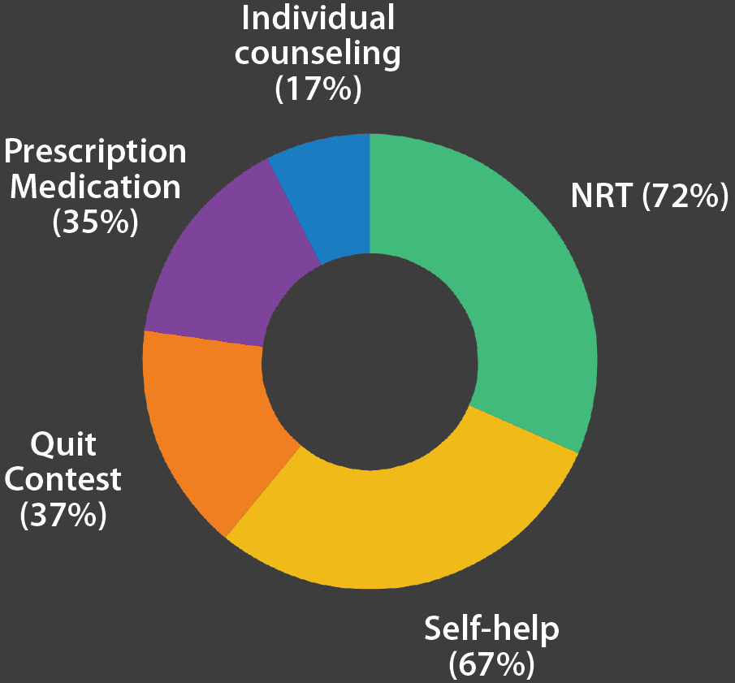

Slide 16
Getting Help

Slide 17


Slide 18
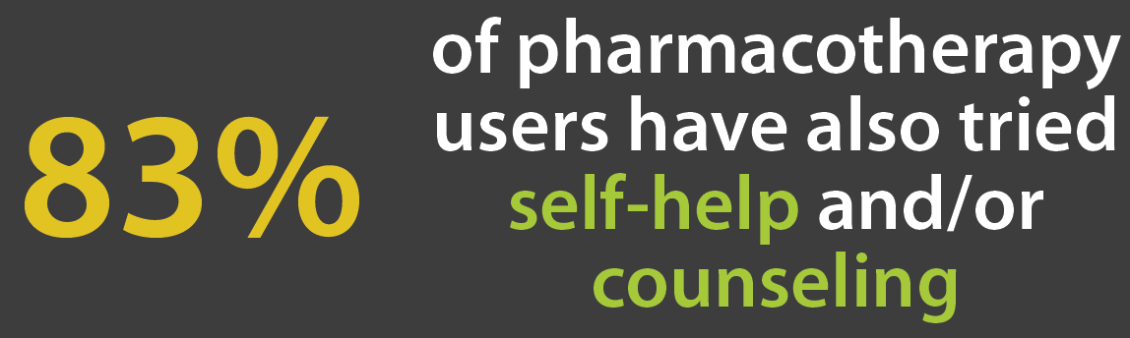

Slide 19


Slide 20


Slide 21
Chances Improve

Slide 22


Slide 23


Slide 24
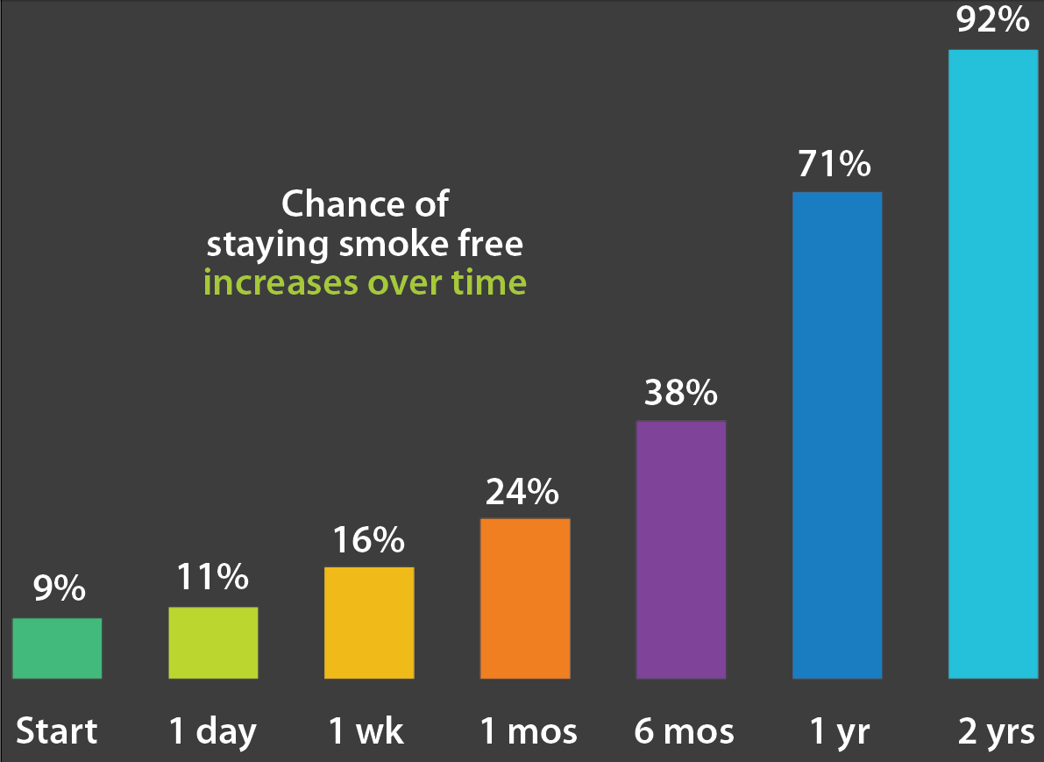

Slide 25
Findings from the Ontario Tobacco Survey and other OTRU studies. To see this poster online and for more details, including references, go to:
http://otru.org/quitting-smoking-in-ontario/
Published November 2013

